Slide 1
Digital Portfolio
STUDENT NAME:D.sudhagar
REGISTER NO AND NMID:31924U09024
DEPARTMENT:B.C.A
COLLEGE: Mazharul uloom college[Autonomous] /Thiruvalluvar UNIVERSITY

Slide 2
PROJECT TITLE
Digital portfolio
1. Showcases personal skills, projects, and achievements.
2. Includes contact information for easy communication.
3. Highlights education, certifications, and experiences.
4. Uses images, screenshots, and visuals for clarity.
5. Acts as a professional online presence for career growth

Slide 3


AGENDA
Problem Statement
Project Overview
End Users
Tools and Technologies
Portfolio design and Layout
Features and Functionality
Results and Screenshots
Conclusion
Github Link
3/21/2024 Annual Review

Slide 4

PROBLEM STATEMENT
1. Defines the main issue or challenge.
2. Explains why the problem needs a solution.
3. Identifies the target users affected.
4. Highlights the impact of the problem.
5. Guides the objectives and scope of the project

Slide 5

PROJECT OVERVIEW
1. Provides a brief description of the project.
2. States the purpose and objectives of the project.
3. Highlights key features or functionalities.
4. Mentions the target audience or users.
5. Summarizes expected outcomes or benefits

Slide 6

WHO ARE THE END USERS?
1. People who directly use the product or service.
2. The main target audience of the project.
3. Individuals whose needs the project aims to fulfill.
4. Users who interact with the system regularly.
5. Beneficiaries of the project’s features and outcomes

Slide 7

TOOLS AND TECHNIQUES
1. Tools are software or applications used in the project.
2. Techniques are methods or processes applied to solve problems.
3. They improve accuracy and efficiency.
4. Different tools suit different project needs.
5. They support successful project development and execution

Slide 8
POTFOLIO DESIGN AND LAYOUT
1. Uses a clean and organized structure.
2. Ensures easy navigation for users.
3. Highlights key sections like About, Skills, and Projects.
4. Incorporates visuals, images, and screenshots effectively.
5. Maintains consistency in fonts, colors, and style
8

Slide 9
FEATURES AND FUNCTIONALITY
1. Describes what the project or system can do.
2. Highlights main tools, services, or components used.
3. Shows how users interact with the system.
4. Explains key benefits or advantages.
5. Demonstrates how objectives are achieved

Slide 10
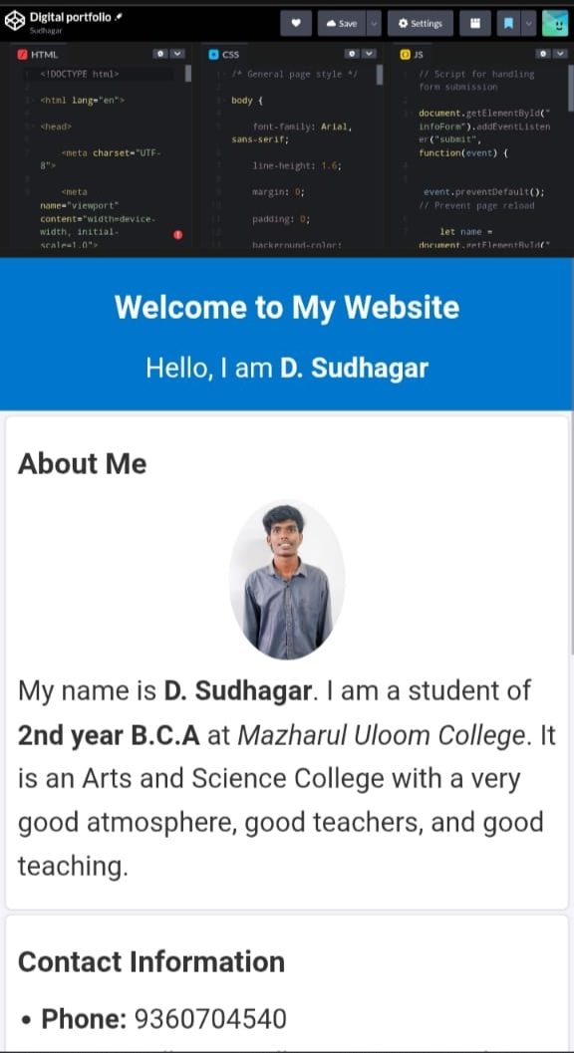

RESULTS AND SCREENSHOTS
1. Shows the final output of the project.
2. Proves whether objectives were achieved.
3. Provides visual evidence of the work done.
4. Makes results clear and easy to understand.
5. Helps in evaluation and verification of the project
3/21/2024 Annual Review
10

Slide 11
CONCLUSION
1. Summarizes the main findings of the project.
2. Confirms whether objectives were achieved.
3. Highlights key learnings and outcomes.
4. Suggests improvements or future enhancements.
5. Reflects the overall success of the project
11

